Slide 1
First Order Logic

Slide 2

First-order Logic [AIMA Ch. 8]
Why FOL?
Syntax and semantics of FOL
Fun with sentences
Wumpus world in FOL

Slide 3

Review: Propositional logic - syntax
Propositional logic is the simplest logic—illustrates basic ideas
The proposition symbols P₁, P₂ etc are sentences
If S is a sentence, ¬S is a sentence (negation)
If S₁ and S₂ are sentences, S₁ ^ S₂ is a sentence (conjunction)
If S₁ and S₂ are sentences, S₁ V S₂ is a sentence (disjunction)
If S₁ and S₂ are sentences, S₁ ➔S₂ is a sentence (implication)
If S₁ and S₂ are sentences, S_{1 ⬅➔} S₂ is a sentence (biconditional)

Slide 4

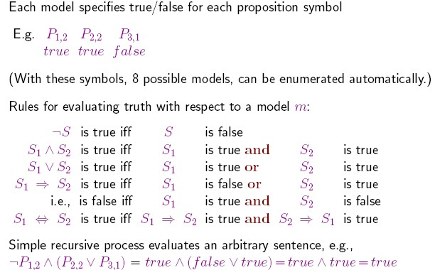
Review: Propositional logic - Semantics

Slide 5
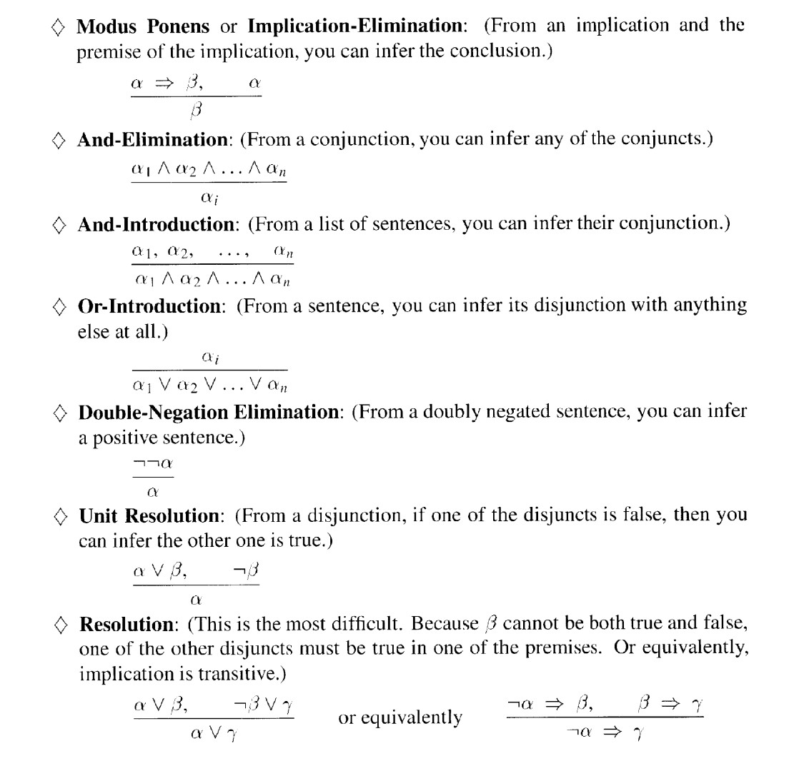
Review propositional logic [cont’d]

Slide 6
Why first-order logic?
Pros and cons of propositional logic
Propositional logic is declarative: pieces of syntax correspond to facts Propositional logic allows partial/disjunctive/negated information
(unlike most data structures and databases)
Propositional logic is compositional:
meaning of B_{1,1} ^ P_{1,2} is derived from meaning of B_{1,1} and of P_{1,2}
Meaning in propositional logic is context-independent (unlike natural language, where meaning depends on context)
Propositional logic has very limited expressive power (unlike natural language)
E.g., cannot say “pits cause breezes in adjacent squares” except by writing one sentence for each square

Slide 7
First-order logic (FOL)
Whereas propositional logic assumes world contains facts, first-order logic (like natural language) assumes the world contains:
Objects: wheel, door, body, engine, seat, car, passenger, driver, people, houses, numbers, theories, Ronald McDonald, colors, baseball games, wars, centuries, …
Predicates: Inside(car, passenger), Beside(driver, passenger), BrotherOf(person, person), BiggerThan(object, object), Inside(), part of(), HasColor(), OccurredAfter(), Owns(), ComesBetween(), …
Functions: ColorOf(car), FatherOf(person), BestFriend(person),
ThirdInningOf(), OneMoreThan(), EndOf(), …
Functions are relations with single value for each object

Slide 8
Logics in general
Logics are characterized by what they commit to as “primitives”
Ontological commitment: what exists—facts? objects? time? beliefs?
Epistemological commitment: what states of knowledge?
Language | Ontological Commitment | Epistemological Commitment
Propositional logic | facts | true/false/unknown
First-order logic | facts, objects, relations | true/false/unknown
Temporal logic | facts, objects, relations, times | true/false/unknown
Probability logic | facts | degree of belief 0…1
Fuzzy logic | facts, degree of truth | known interval value
10

Slide 9
Semantics/Interpretation
there is a correspondence between
functions, which return values
predicates, which are true or false
Function: father_of(Mary) = Bill Predicate: father_of(Mary, Bill)

Slide 10
Examples:
“One plus two equals three”
Objects: Predicates: Functions:
“Squares neighboring the Wumpus are smelly”
Objects: Predicates: Functions:

Slide 11
Examples:
“One plus two equals three”
Objects:
one, two, three, one plus two
Predicates: equals
Functions:
plus (“one plus two” is the name of the object obtained by applying function plus to one and two, three is another name for this object)
“Squares neighboring the Wumpus are smelly”
Objects: Wumpus, square Predicates: neighboring, smelly Functions: --

Slide 12
FOL: Syntax of basic elements
Constant symbols: 1, 5, A, B, USC, JPL, Alex, Manos, …
Predicate symbols: >, Friend, Student, Colleague, …
Function symbols: +, sqrt, SchoolOf, TeacherOf, ClassOf, …
Variables: x, y, z, next, first, last, …
Connectives: ∧, ∨, ⇒, ⇔
Quantifiers: ∀, ∃
Equality: =

Slide 13
FOL: Atomic sentences
AtomicSentence
= predicate(term₁, …, term_{n})
or term₁= term₂
Term = function(term₁, …, term_{n})
or constant or variable
Examples:
SchoolOf(Manos)
Colleague(TeacherOf(Alex), TeacherOf(Manos))
◦ >((+ x y), x)

Slide 14
FOL: Complex sentences
Complex sentences are made from atomic sentences using connectives
¬S, S₁ ^ S₂, S₁ V S₂, S₁ ➔ S₂, S_{1 ⬄} S₂
AtomicSentence
| Sentence Connective Sentence
| Quantifier Variable, … Sentence
| ¬ Sentence
| (Sentence)
Sentence →
Examples:
Colleague(Paolo, Maja) ➔ Colleague(Maja, Paolo) Student(Alex, Paolo) ➔ Teacher(Paolo, Alex)

Slide 15
Truth in first-order logic
Sentences in FOL are interpreted with respect to a
model and an interpretation
Model contains ≥ 1 objects (domain elements) and relations among them
Interpretation specifies refererents for
Constant symbols: refer to objects
Predicate symbols: refer to relations
Function symbols: refer to functional Relations
An atomic sentence predicate(term₁, …, term_{n}) is true iff the objects referred to by term₁, …, term_{n} are in the relation referred to by predicate

Slide 16
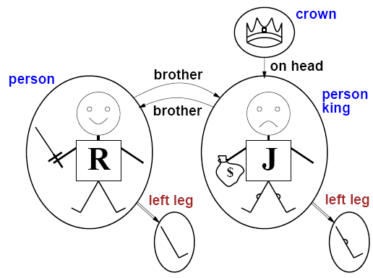
Models for FOL: Example

Slide 17
Truth example
Consider the interpretation in which
Richard → Richard the Lionheart
John → the evil King John
Brother → the brother relation
Under this interpretation, Brother(Richard, John) is true just in case Richard the Lionheart and the evil King John are in the brother relation in the model

Slide 18
Models for FOL: Lots!
Entailment in propositional logic can be computed by enumerating models
We can enumerate the FOL models for a given KB vocabulary:
For each number of domain elements n from 1 to 1
For each k-ary predicate P_{k} in the vocabulary For each possible k-ary relation on n objects
For each constant symbol C in the vocabulary
For each choice of referent for C from n objects …
Computing entailment by enumerating FOL models is not easy!
20

Slide 19
Quantifiers
Expressing sentences about collections of objects without enumeration (naming individuals)
E.g., All Trojans are clever
Someone in the class is sleeping
Universal quantification (for all): ∀
Existential quantification (there exists): ∃

Slide 20

Universal quantification (for all):
∀ <variables> <sentence>
“Every one in the cs561 class is smart”:
∀ x In(cs561, x) ⇒ Smart(x)
∀ P corresponds to the conjunction of instantiations of P
In(cs561, Manos) ⇒ Smart(Manos) ∧
In(cs561, Dan) ⇒ Smart(Dan) ∧
…
In(cs561, Bush) ⇒ Smart(Bush)

Slide 21
Universal quantification (for all):
⇒ is a natural connective to use with ∀
Common mistake: to use ∧ in conjunction with ∀
∀ x In(cs561, x) ^ Smart(x)
means “every one is in cs561 and everyone is smart”

Slide 22

Existential quantification (there exists):
∃ <variables> <sentence>
“Someone in the cs561 class is smart”:
∃ x In(cs561, x) ^ Smart(x)
∃ x P
is true in a model m iff P is true with x being some
possible object in the model
∃ P corresponds to the disjunction of instantiations of P
(In(cs561, Manos) ^ Smart(Manos) ) _
(In(cs561, Dan) ^ Smart(Dan) ) _
…
(In(cs561, Bush) ^ Smart(Bush) )

Slide 23
Existential quantification (there exists):
∧ is a natural connective to use with ∃
Common mistake: to use ⇒ in conjunction with ∃
∃ x In(cs561, x) ⇒ Smart(x)
is true if there is anyone that is not in cs561! (remember, false ⇒ true is valid).

Slide 24
Examples…
∀x In(cs561, x) ⇒ Smart(x)
In(cs561, x) ^ Smart(x)
∀x In(cs561, x) ^ Smart(x)
∃x In(cs561, x) ^ Smart(x)
∃x In(cs561, x) ⇒ Smart(x)
X
X
X
X
X X
X
X
X
X X
X
X
X
_{X} X X
X
X X
X X
X
X X
X X
X
X
X
X X
X X
X
X
X X
¬In(cs561, x) _ Smart(x)

Slide 25
Examples…
∀x In(cs561, x) ⇒ Smart(x)
∀x In(cs561, x) ^ Smart(x)
∃x In(cs561, x) ^ Smart(x)
∃x In(cs561, x) ⇒ Smart(x)
X
X
X
X
X X
X
X
X
X X
X
X
X
_{X} X X
X
X X
X X
X
X X
X X
X
X
X
X X
X X
X
X
X X

Slide 26
Examples…
∀x In(cs561, x) ⇒ Smart(x)
∀x In(cs561, x) ^ Smart(x)
In(cs561, x) ^ Smart(x)
∃x In(cs561, x) ^ Smart(x)
X
X
∃x In(cs561, x) ⇒ Smart(x)
X
X
X
X X
X X
X
X
X
X
X
_{X} X X
X
X X
X X
X
X X
X X
X
X
X
X X
X X
X
X
X X

Slide 27
Examples…
∀x In(cs561, x) ⇒ Smart(x)
∀x In(cs561, x) ^ Smart(x)
∃x In(cs561, x) ^ Smart(x)
X
X
∃x In(cs561, x) ⇒ Smart(x)
X
X
X
X X
X X
X
X
X
X
X
_{X} X X
X
X X
X X
X
X X
X X
X
X
X
¬In(cs561, x)
X X
X X
X
X
X X

Slide 28
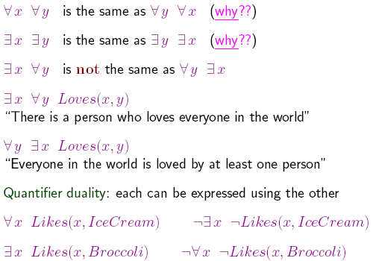
Properties of quantifiers
30

Slide 29
Fun with sentences
Brothers are siblings
∀ x,y Brother(x,y) ⇒ Sibling(x,y)
“Sibling” is symmetric
∀ x,y Sibling(x,y) ⬄ Sibling(y,x)
One’s mother is one’s female parent
∀ x,y Mother(x,y) ⬄ (Female(x)^Parent(x,y))
A first cousin is a child of a parent’s sibling
∀ x,y FirstCousin(x,y) ⬄ ∃ p,ps Parent(p,x)
^Sibling(ps,p) ^Parent(ps,y))

Slide 30
Translating English to FOL
Every gardener likes the sun.
∀ x gardener(x) => likes(x,Sun)
You can fool some of the people all of the time.
∃ x ∀ t (person(x) ^ time(t)) => can-fool(x,t)

Slide 31
Translating English to FOL
You can fool all of the people some of the time.
∀ x ∃ t (person(x) ^ time(t)) => can-fool(x,t)
∃ t ∀ x (person(x) ^ time(t)) => can-fool(x,t)
→ You can fool all of the people at the same time.
All purple mushrooms are poisonous.
∀ x (mushroom(x) ^
purple(x)) => poisonous(x)

Slide 32
Translating English to FOL…
No purple mushroom is poisonous.
¬(∃ x) purple(x) ^ mushroom(x) ^
poisonous(x)
or, equivalently,
(∀ x) (mushroom(x) ^
purple(x)) =>
¬poisonous(x)

Slide 33
Equality
term₁= term₂ is true under a given interpretation if and only if term₁ and term₂ refer to the same object
E.g.,
∀ x (* Sqrt(x) Sqrt(x)) = x is satisfiable 2 = 2 is valid
E.g., definition of (full) Sibling in terms of Parent:
∀ x,y Sibling(x, y) ⬄ [¬(x=y) ^ ∃ m, f ¬(m=f) ^ Parent(m, x) ^
Parent(f, x) ^ Parent(m, y) ^ Parent(f, y)]

Slide 34
Higher-order logic?
First-order logic allows us to quantify over objects (= the first-order entities that exist in the world).
Higher-order logic also allows quantification over
relations and functions.
e.g., “two objects are equal iff all properties applied to them are equivalent”:
∀ x,y (x=y) ⇔ (∀ p, p(x) ⇔ p(y))
Higher-order logics are more expressive than first- order, however, so far we have little understanding on how to effectively reason with sentences in higher-order logic.

Slide 35
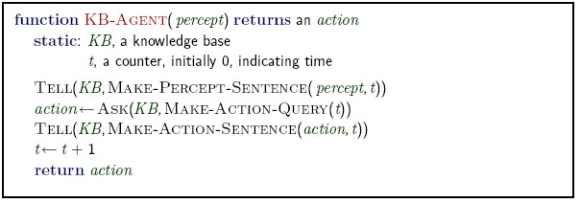
Logical agents for the Wumpus world
Remember: generic knowledge-based agent:
TELL KB what was perceived
Uses a KRL to insert new sentences, representations of facts, into KB
ASK KB what to do.
Uses logical reasoning to examine actions and select best.

Slide 36
Interacting with FOL KBs
Suppose a wumpus-world agent is using an FOL KB and perceives a smell and a breeze (but no glitter) at t = 5:
Tell(KB, Percept([Smell, Breeze, None], 5))
Ask(KB, ∃ a Action(a, 5))
I.e., does KB entail any particular actions at t = 5?
Answer: Yes, {a/Shoot} ← substitution (binding list)
Set of solutions
Given a sentence S and a substitution α,
S denotes the result of plugging
S = Smarter(x, y)
α = {x/Hillary, y/Bill}
Sα = Smarter(Hillary, Bill)
into S, e.g.,
Ask(KB, S) returns some/all α such that KB ╞ S α

Slide 37
Knowledge base for the wumpus world
“Perception”
∀ b, g, t Percept([Smell, b, g], t) ➔ Smelt(t)
∀ s, b, t Percept([s, b, Glitter], t) ➔ AtGold(t)
Reflex: ∀ t AtGold(t) ➔ Action(Grab, t)
Reflex with internal state: do we have the gold already?
∀ t AtGold(t) ^ : ¬ Holding(Gold, t) ➔ Action(Grab, t)
Holding(Gold, t) cannot be observed ➔
keeping track of change is essential

Slide 38
Deducing hidden properties
Properties of locations:
∀ x, t At(Agent, x, t) ^ Smelt(t) ➔ Smelly(x)
∀ x, t At(Agent, x, t) ^ Breeze(t) ➔ Breezy(x)
Squares are breezy near a pit:
Diagnostic rule—infer cause from effect
∀ y Breezy(y) ➔ ∃x Pit(x) ^ Adjacent(x, y)
Causal rule—infer effect from cause
∀ x, y Pit(x) ^ Adjacent(x, y) ➔ Breezy(y)
Neither of these is complete—e.g., the causal rule doesn't say
whether squares far away from pits can be breezy
Definition for the Breezy predicate:
∀ y Breezy(y) ⬄ [∃x Pit(x) ^ Adjacent(x, y)]

Slide 39
KNOWLEDGE ENGINEERING IN FIRST-ORDER LOGIC
Identify the task.
Assemble the relevant knowledge.
Decide on a vocabulary of predicates, functions, and constants
Encode general knowledge about the domain
Encode a description of the specific problem instance
Pose queries to the inference procedure and get answers
Debug the knowledge base

Slide 40
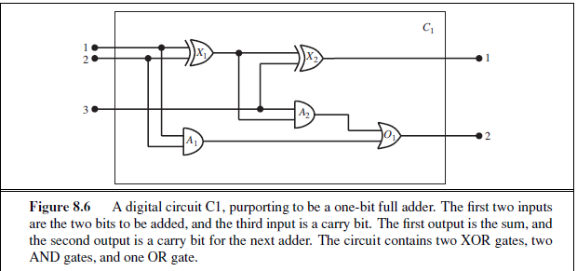
The electronic circuits domain

Slide 41

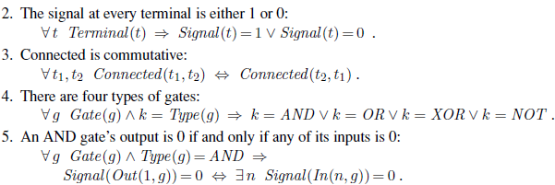
Encode general knowledge of the domain

Slide 42
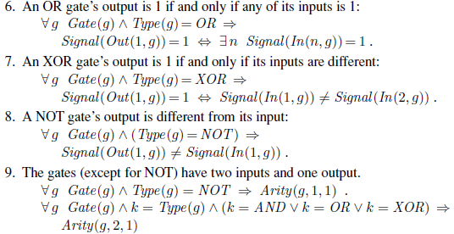
Encode general knowledge of the domain

Slide 43
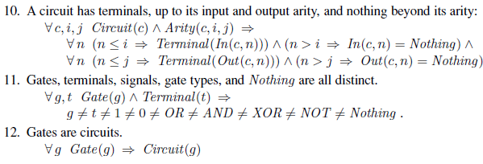
Encode general knowledge of the domain

Slide 44
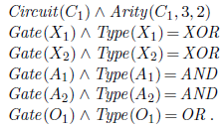
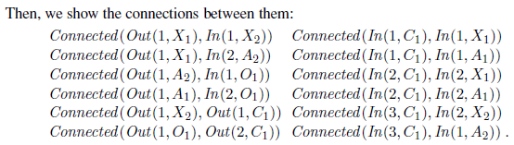
Encode the specific problem instance

Slide 45
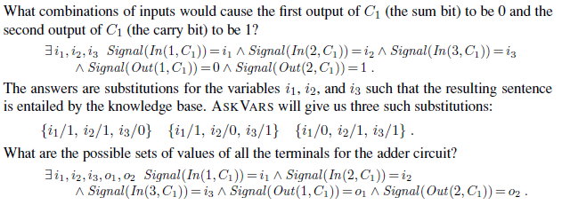
Pose queries to the inference procedure

Slide 46
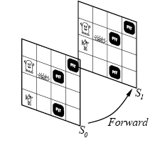
Situation Calculus (Keeping Track of Change)
Facts hold in situations, rather than eternally
E.g., Holding(Gold, Now) rather than just Holding(Gold)
Situation calculus is one way to represent change in FOL: Adds a situation argument to each non-eternal predicate E.g., Now in Holding(Gold, Now) denotes a situation
Situations are connected by the Result function
Result(a, s) is the situation that results from doing a in s

Slide 47
Describing actions
“Effect” axiom—describe changes due to action
∀ AtGold(s) ➔ Holding(Gold, Result(Grab, s))
“Frame” axiom—describe non-changes due to action
∀ s HaveArrow(s) ➔ HaveArrow(Result(Grab, s))
Frame problem: find an elegant way to handle non-change
representation—avoid frame axioms
inference—avoid repeated “copy-overs” to keep track of state
Qualification problem: true descriptions of real actions require endless caveats—what if gold is slippery or nailed down or …
Ramification problem: real actions have many secondary consequences—what about the dust on the gold, wear and tear on gloves, …

Slide 48
Describing actions (cont’d)
Successor-state axioms solve the representational frame problem
Each axiom is “about” a predicate (not an action per se):
P true afterwards ⬄ [an action made P true
V P true already and no action made P false]
For holding the gold:
∀ a, s Holding(Gold, Result(a, s)) ⬄
[(a=Grab ^ AtGold(s))
V (Holding(Gold, s) ^ a ≠ Release)]

Slide 49
Making plans
Initial condition in KB:
At(Agent, [1, 1], S₀)
At(Gold, [1, 2], S₀)
Query: Ask(KB, ∃s Holding(Gold, s))
i.e., in what situation will I be holding the gold?
Answer: {s/Result(Grab, Result(Forward, S₀))}
i.e., go forward and then grab the gold
This assumes that the agent is interested in plans starting at S₀ and
that S₀ is the only situation described in the KB

Slide 50
Making plans: A better way
Represent plans as action sequences [a₁, a₂ , … , a_{n}]
PlanResult(p, s) is the result of executing p in s
Then the query Ask(KB, ∃ p Holding(Gold, PlanResult(p, S0)))
has the solution {p/[Forward, Grab]}
Definition of PlanResult in terms of Result:
∀ s PlanResult([], s) = s
∀ a, p, s PlanResult([a|p], s) = PlanResult(p, Result(a, s))
Planning systems are special-purpose reasoners designed to do this type of inference more efficiently than a general- purpose reasoner

Slide 51
Summary
First-order logic:
objects and relations are semantic primitives
syntax: constants, functions, predicates, equality, quantifiers
Increased expressive power: sufficient to define
Wumpus world
Situation calculus:
conventions for describing actions and change in FOL
can formulate planning as inference on a situation calculus KB

